Slide 1
Introduction to Business Analytics
Module 1

Slide 2
Curtain raiser…
What do you mean by Business Intelligence, Analytics, Data Science, and Artificial Intelligence?
Systems for Decision Support
VUCA
Volatile, Uncertain, Complexity and Ambiguity

Slide 3
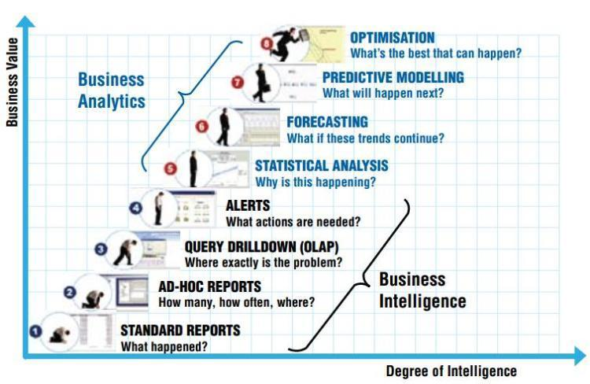
BI vs BA

Slide 4
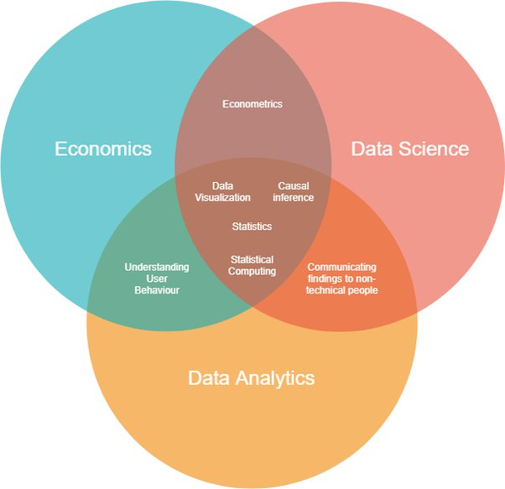
Economics, Data Science and Data Analytics

Slide 5
The science of deriving predictions from the insights inorder to benefit the business
The science of processing structured and unstructured data so that meaningful insights can be derived from it
Make machine perform cognitive functions
Big Data
Artificial Intelligence
Use algorithms to make the AI learn without programming it explicitly
Curating meaningful insights from the data
Machine Learning
Data Analytics
Data Science
Cascade of neural networks, part of ML
Deep Learning

Slide 6
Introduction
Business environment (climate) is constantly changing, and it is becoming more and more complex
Evolving needs
Quick Decision making
Organizations became agile
Quick, tactical, operational decisions
Needs relevant data

Slide 7
How Intelligent Systems Work for KONE Elevators and Escalators Company?
KONE is a global industrial company (based in Finland) that manufactures mostly elevators and escalators and also services over 1.1 million elevators, escalators, and related equipment in several countries. The company employs over 50,000 people.
THE PROBLEM
Over 1 billion people use the elevators and escalators manufactured and serviced by KONE every day. If equipment does not work properly, people may be late to work, cannot get home in time, and may miss important meetings and events. So, KONE’s objective is to minimize the downtime and users’ suffering.
The company has over 20,000 technicians who are dispatched to deal with the elevators anytime a problem occurs. As buildings are getting higher (the trend in many places), more people are using elevators, and there is more pressure on elevators to handle the growing amount of traffic. KONE faced the responsibility to serve users smoothly and safely.

Slide 8
Solution
KONE used
IBM Watson IoT Cloud Platform
IoT connected sensors
Data Collected
(noise levels)
IoT transferring data to info. centre
IBM Advanced Analytic Engine & AI predict Things
Identified likely causes and suggest potential problems
Financial aspects of managing the elevators.
Minimized downtime
Predictive power
Future Design
Shortened Repair time
Service Cloud Lightning and Field Service Lightning
Emergencies – Dispatching technicians to the site
Trouble-free rides
Optimize maintenance staff
Trouble-free rides
Salesforce service tools

Slide 9
Changing business environments and evolving needs for decision support and analytics
Decision making is one of the most important activities in organizations
Decision making leads to the success or failure of organizations
Making decisions is getting difficult due to internal and external factors.
De Smet et al. (2017) of McKinsey & Company management
Big-bet, high-risk decisions.
Cross-cutting decisions, which are repetitive but high risk
Ad hoc decisions that arise episodically.
Delegated decisions to individuals or small groups

Slide 10
Decision-Making Process
Managers usually make decisions by following a four-step process
Define the problem (i.e., a decision situation that may deal with some difficulty or with an opportunity).
Construct a model that describes the real-world problem.
Identify possible solutions to the modeled problem and evaluate the solutions.
Compare, choose, and recommend a potential solution to the problem.
A more detailed process is offered by Quain (2018), who suggests the following steps:
Understand the decision you have to make.
Collect all the information.
Identify the alternatives.
Evaluate the pros and cons.
Select the best alternative.
Make the decision.
Evaluate the impact of your decision.

Slide 11
Data and Its Analysis in Decision Making
The data doubles every two years.
Information technology is vital
Computer applications have moved from transaction-processing and monitoring activities to problem analysis and solution applications,
Through cloud-based technologies, can accessed through mobile devices.
Analytics and BI tools
data warehousing,
data mining,
online analytical processing (OLAP),
dashboards,
The use of cloud-based systems for decision support are the cornerstones of today’s modern management.
Managers must have high-speed, networked information systems for making decisions.

Slide 12
Technologies for Data Analysis and Decision Support
Group communication and collaboration
Groups, distant locations, collaborations (Supply Chain)
Analytical support
forecasts can be improved,
risk analysis can be performed quickly,
Anywhere, anytime support
wireless technology
Access information anytime and from any place, analyze and interpret it, and communicate
Improved data management
search, store, and transmit needed data quickly, economically, securely, and transparently
Overcoming cognitive limits in processing and storing information
human mind has only a limited ability
Innovation and artificial intelligence
AI is integrated with analytics, creating synergy in making
decision
Managing giant data warehouses and Big Data
parallel computing
different view of organizational performance
Knowledge management
own operations, customers, internal procedures, employee interactions
Knowledge management systems

Slide 13
Simon’s Decision Making Process: Intelligence, Design, and Choice
decision maker examines reality and identifies and defines the problem &
Problem ownership
system is constructed
making assumptions
relationships among all the variables.
model is validated
Decision making is a process of choosing among two or more alternative courses of action for the purpose of attaining one or more goals

Slide 14
ISSUES IN DATA COLLECTION
Data are not available. As a result, the model is made with and relies on potentially inaccurate estimates.
Obtaining data may be expensive.
Data may not be accurate or precise enough.
Data estimation is often subjective.
Data may be insecure.
Important data that influence the results may be qualitative (soft).
There may be too many data (i.e., information overload).
Outcomes (or results) may occur over an extended period.
As a result, revenues, expenses, and profits will be recorded at different points in time.
It is assumed that future data will be similar to historical data.
If not, the nature of the change has to be predicted and included in the analysis.

Slide 15
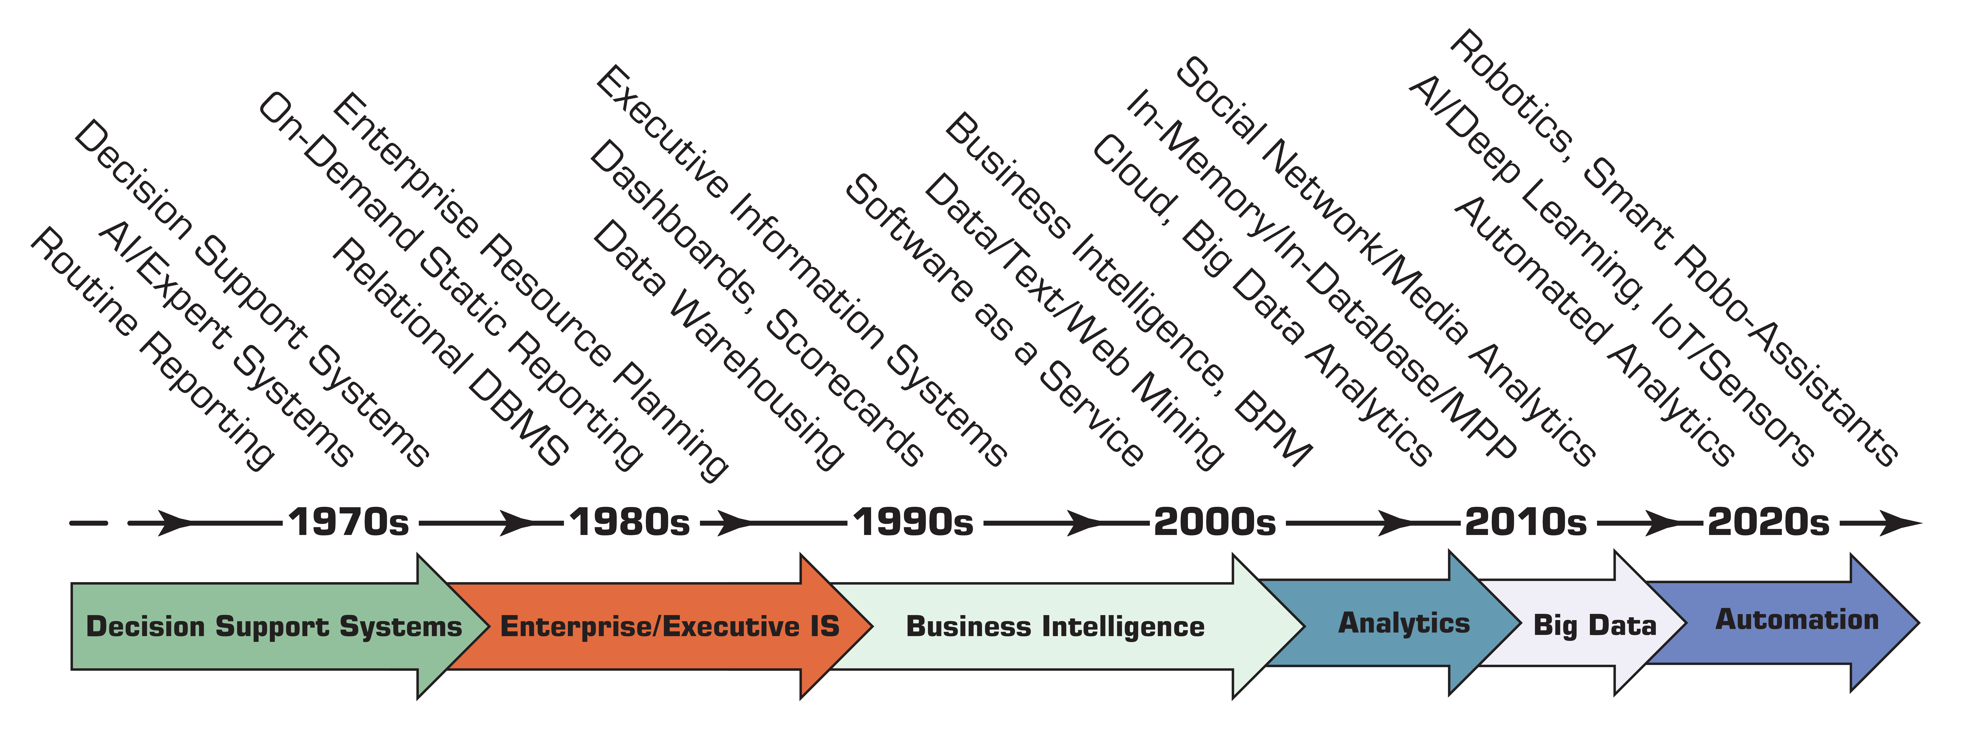
Evolution of Computerized Decision Support to Business Intelligence/Analytics/Data Science

Slide 16
Extract transform load
Evolution of Business Intelligence (BI).

Slide 17
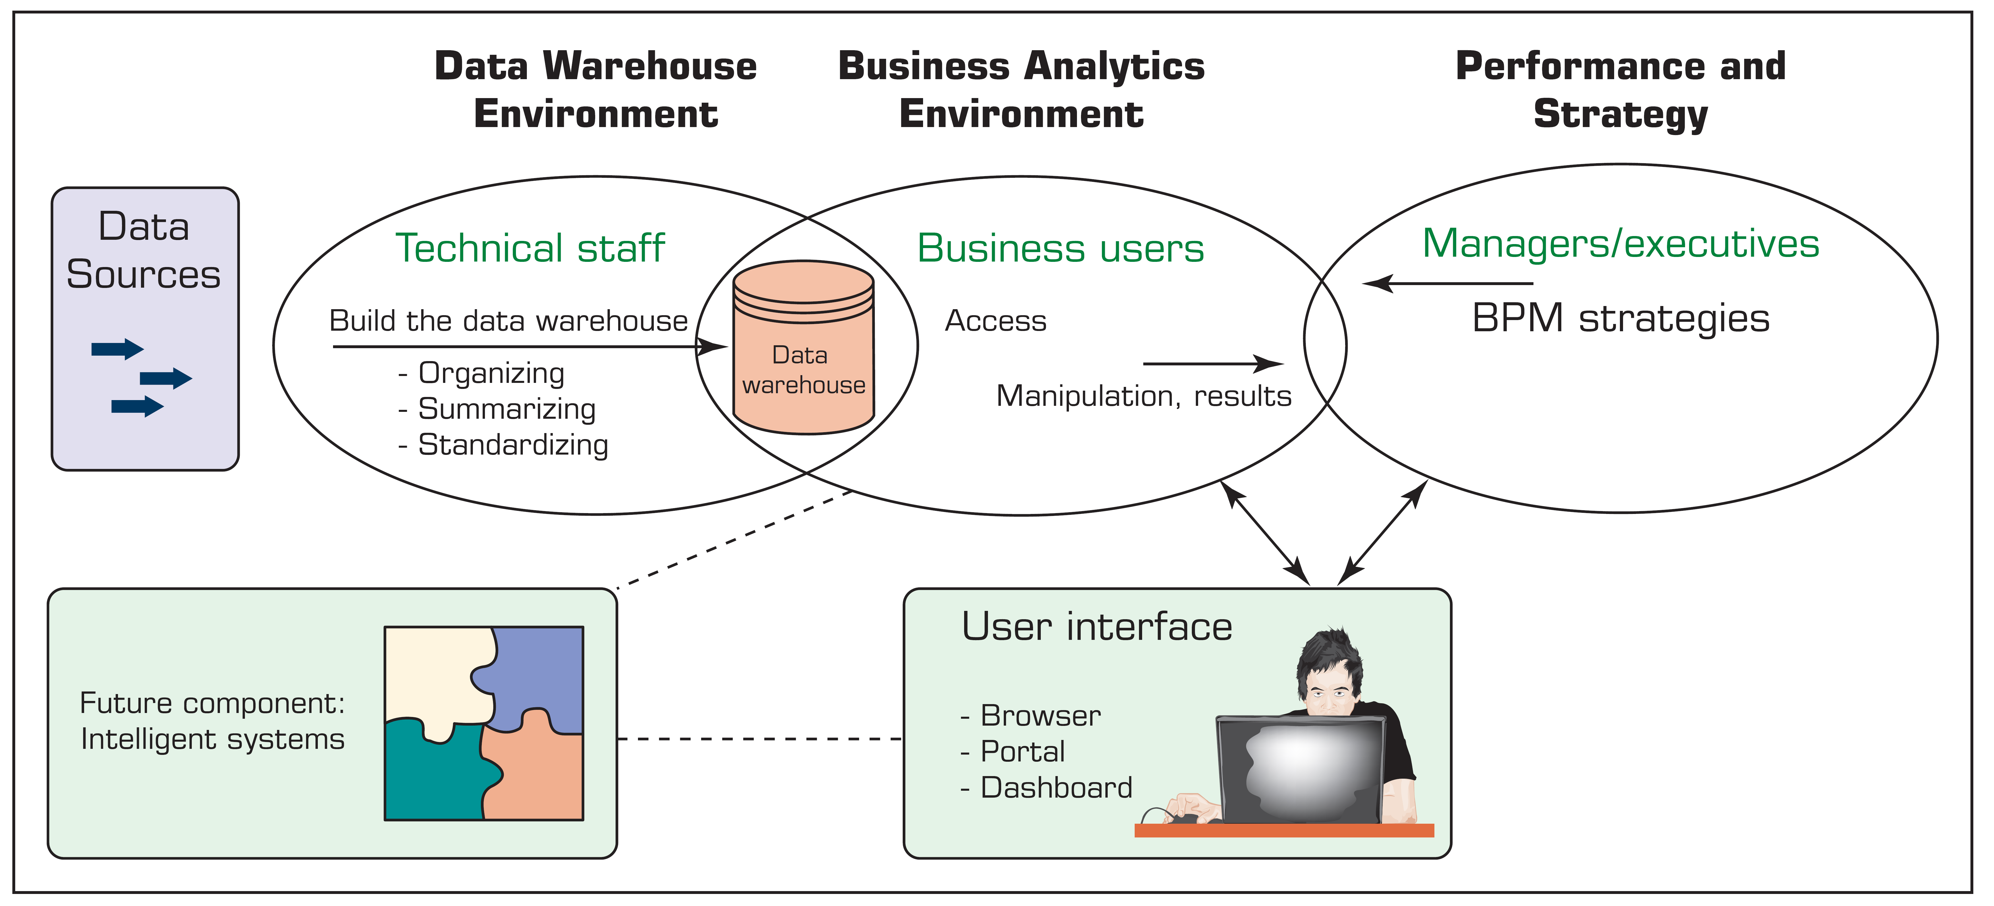
The Origins and Drivers of BI

Slide 18
Data Warehouse Framework and Views

Slide 19
Overview of BA

Slide 20
Artificial Intelligence
AI is concerned with two basic ideas:
the study of human thought processes (to understand what intelligence is) and
the representation and duplication of those thought processes in machines (e.g., computers, robots).
The machines are expected to have humanlike thought processes.
“the capabilities of a machine to imitate intelligent human behavior” (Merriam-Webster Dictionary).

Slide 21
The Functionalities and Applications of Artificial Intelligence.

Slide 22
Major Goals of AI
To create intelligent machines that are capable of executing a variety of tasks currently done by people
Perceive and properly react to changes in the environment that influence specific business processes and operations.
Introduce creativity in business processes and decision making

Slide 23
Drivers of AI
People’s interest in smart machines and artificial brains
The low cost of AI applications versus the high cost of manual labor
The desire to capture competitive advantage and market share
To increase productivity and speed
The availability of quality data contributing to the progress of AI
The increasing functionalities and reduced cost of computers in general
The development of new technologies, particularly cloud computing

Slide 24
Applications of AI
AI is starting to revolutionize business recruitment by (1) conducting more efficient and fairer candidate screening, (2) making better matches of candidates to jobs, and (3) helping safeguard future talent pipelines for organizations.
Accenture Inc. developed AI-powered solutions using natural language processing (NLP) and image recognition to help blind people in India improve the way that they can experience the world around them
Ford Motor Credit uses machine learning to spot overlooked borrowers, the system predicts potential borrowers’ creditworthiness, thus minimizing losses for Ford.

Slide 25
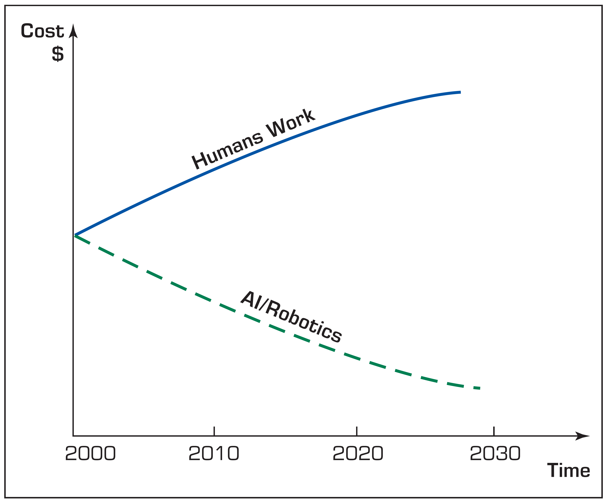
Limitations of AI Machines
Lack human touch and feel
Lack attention to non-task surroundings
Can lead people to rely on AI machines too much (e.g., people may stop to think on their own)
Can be programmed to create destruction
Can cause many people to lose their jobs
Can start to think by themselves, causing significant damage
Cost of Human Work versus the Cost of AI Work

Slide 26
DATA
Data are the main ingredient for any BI, data science, and business analytics initiative.

Slide 27
A Data to Knowledge Continuum

